Slide 1
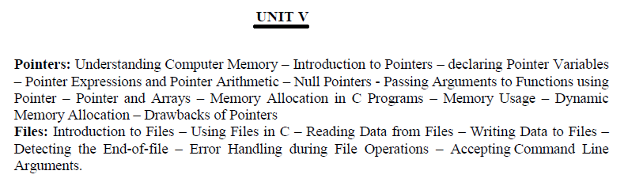

Slide 2
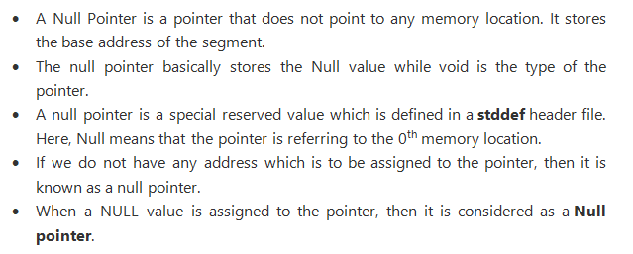
What is a Null Pointer?

Slide 3
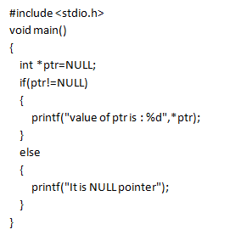
Example 1:

Slide 4
Void pointer
A void pointer is a pointer that has no associated data type with it. A void pointer can hold address of any type and can be type casted to any type. Void pointer is also called as generic pointer.
int a = 10;
char b = 'x';
void *p = &a; // void pointer holds address of int 'a‘
p = &b; // void pointer holds address of char 'b'

Slide 5
Example:
#include<stdio.h>
void main()
{
int a=10;
float b=1.23445;
char c='@';
void *p;
printf(" The address of a=%u",&a);
printf(" \n The address of b=%u",&b);
printf(" \n The address of c=%u",&c);
p=&a;
printf(" \n The value of p=%d",p);
p=&b;
printf(" \n The value of p=%d",p);
p=&c;
printf(" \n The value of p=%d",p);
}

Slide 6
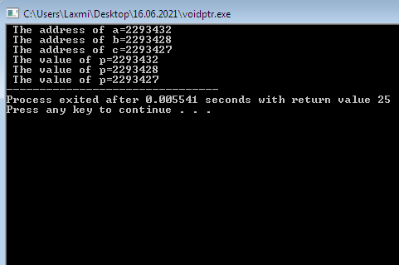
Output:

